Slide 1




CREATED BY:
PHUC DINH
Sales & Customer Analytics
Revenue, Profitability & Growth Strategy

Slide 2


DATA SOURCES:
Dataset : Sales and Customer Insight (E-Commerce)
Source: https://www.kaggle.com/code/ashikshahriar/sales-and-customer-insight
Structure: 15 columns and 10,000 rows
About Project
DATA & TOOLS
Dataset: ~10K customers with category, region, season, LTV, churn, and retention strategy fields
Focus on North and South America segments
Tools used: SQL (views, aggregations, CTE), Power BI (dashboards, DAX, tables).
Key metrics available: revenue, Lifetime Value, purchase frequency, average order value, churn probability
End-to-end BI project using SQL, Power BI and customer-level transaction
PROJECT GOALS
Identifying which customers and product categories drive the most revenue and lifetime value
Comparing purchase behavior (frequency, basket size, timing) across segments
Understanding churn and retention by region, category, season, and retention strategy
Finding segments with good growth or optimization potential

Slide 3
Dashboard Structure
01
CATEGORY OVERVIEW
SEASON & REGION
PERFORMANCE
02
03
CHURN & RETENTION
04
GROWTH OPPORTUNITIES

Slide 4
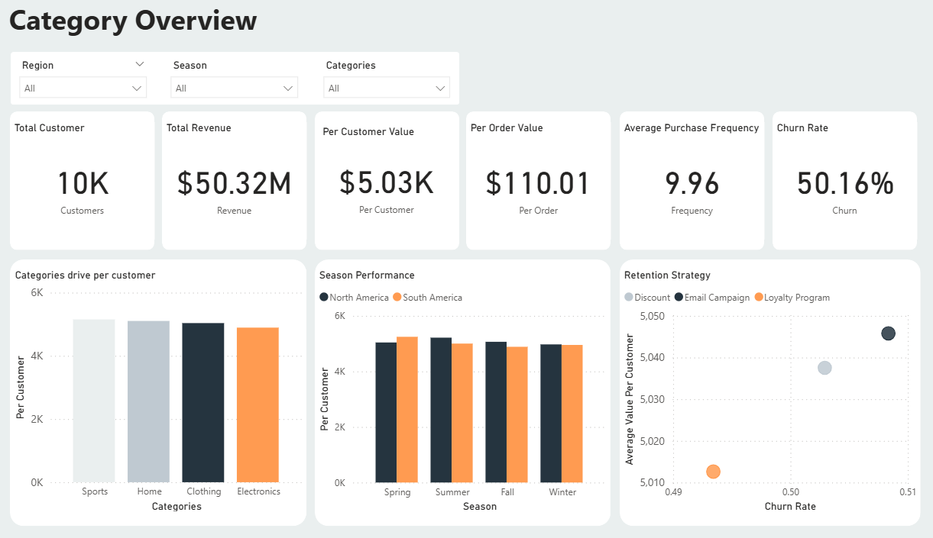

Slide 5
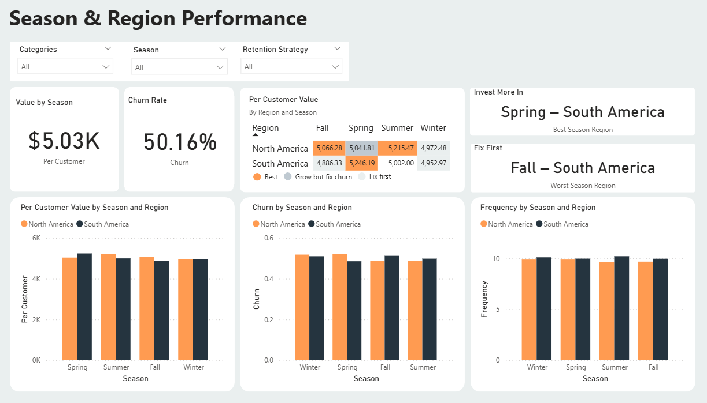

Slide 6
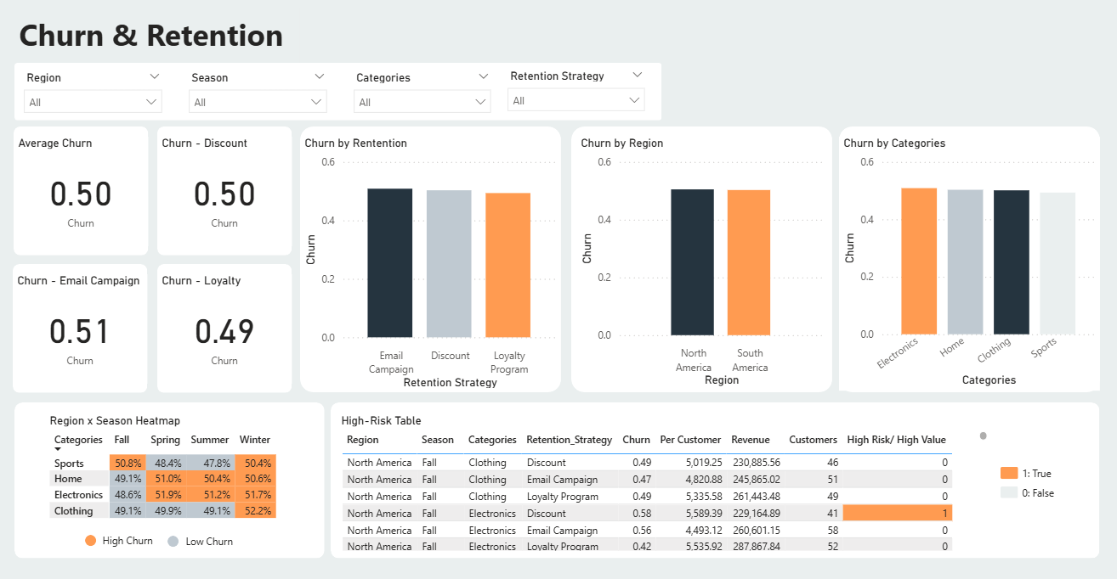

Slide 7
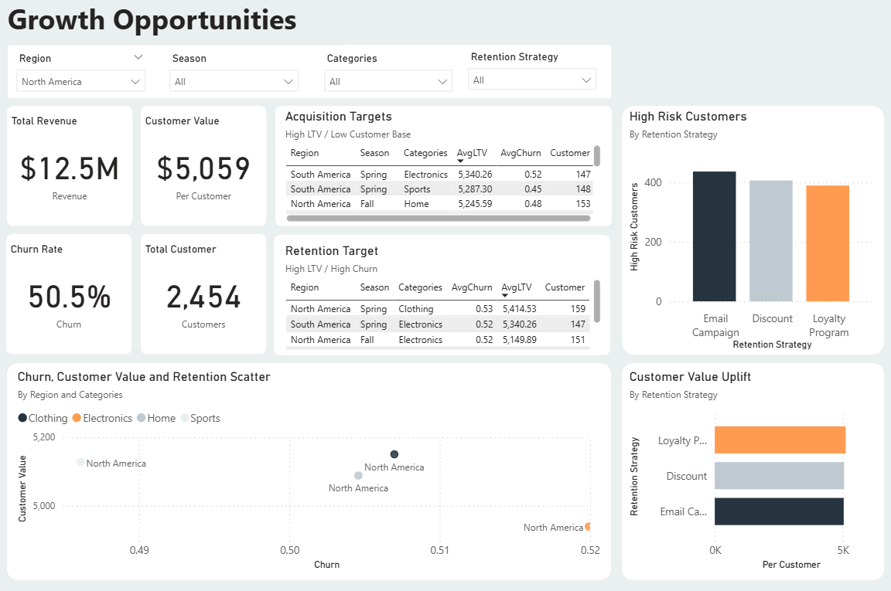

Slide 8
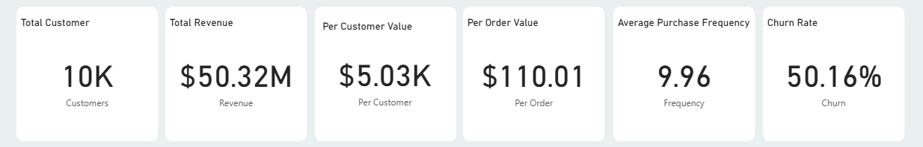
High-Level KPIs
CLEAR VISION
PROCESS OPTIMIZATION
01
02
Aligning organizational goals with long-term strategic objectives.

Slide 9
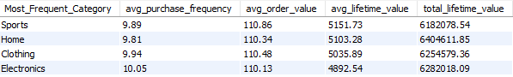
Categories driving LTV & Revenue
SPORT
HOME
CLOTHING
ELECTRONICS
Sports customers have the highest average Lifetime Value per person.
Home has the highest total Lifetime Value due to a large customer base.
Clothing performs in the middle on both value and risk.
Electronics contributes strong revenue but shows higher churn risk.
GENERAL
Customers spend roughly similar amounts per order across categories; differences come mostly from purchase frequency and retention.

Slide 10
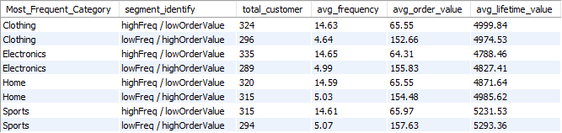
Puchase Frequency vs Basket size
HIGH FREQUENCY / LOW ORDER VALUE
Buy often but with small baskets
IMPLICATION
Design separate playbooks for “small but frequent” and “rare but big” customers in each category
LOW FREQUENCY / HIGH ORDER VALUE
Buy rarely but with large baskets and still generate strong Lifetime Value

Slide 11
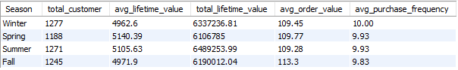
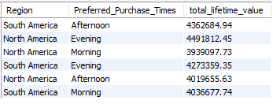
Seasonality
SUMMER
FALL
WINTER
Peak season for Revenue.
Spend slightly more per order but show the lowest total Lifetime value, indicating higher churn risk.
Slightly below average in both value and revenue
Timing
SPRING
with Summer are the most valuable per customer.
SOUTH
NORTH
Clothing & Home peak in evening
Electronics & Sports peak in afternoon
Evening Purchases generate the highest Revenue.
while morning is weakest

Slide 12
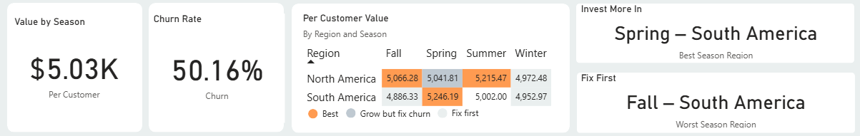
Regional View
North America has higher average Lifetime Value per customer.
Average churn rate is similar across both regions at around 0.50.
Strategic focus for North America: acquire more customers because each additional customer is already high value.
Strategic focus for South America: retention and upsell to increase value from a large existing base.

Slide 13
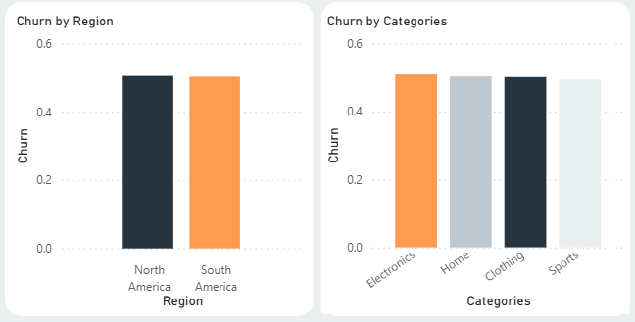
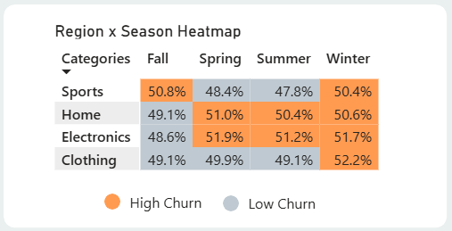
Churn by Category, Season and Region
By region, North and South America have very similar churn, around 0.50, so region alone is not the main driver.
By category, Electronics has the highest churn, while Sports is the lowest; Home and Clothing are close to the average.
The Region × Season heatmap shows that Sports and Electronics in Fall and Winter cross 50% churn and are flagged as high-risk cells.
The High-Risk Table highlights specific North America Fall Clothing and Electronics segments where churn is high but per‑customer value and revenue are still strong, making them priority targets for retention.

Slide 14
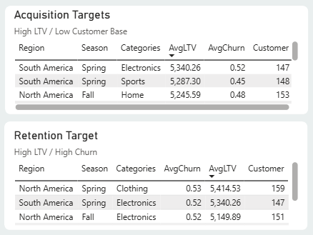
Growth & Optimization
Acquisition targets: segments with high Lifetime Value but low customer counts.
Spring South America: Electronics, Sports, and Clothing show high value per customer with relatively small bases.
North America Spring Sports also combines high value per customer with a smaller base.
Retention targets: segments with high Lifetime Value and high churn.
Several Region x Season x Category pairs generate decent revenue despite high churn, indicating optimization opportunities.

Slide 15
Segment Strategy Playbook
HIGH-FREQUENCY, LOW-ORDER-VALUE CUSTOMER
LOW-FREQUENCY, HIGH-ORDER-VALUE CUSTOMER
Promote bundles, add-ons, and volume discounts to grow basket size.
focus on retention, reactivation, and VIP-style offers, because each extra purchase adds large Lifetime Value.
RETENTION PROGRAM
TACTIC BY CATEGORY
Make Loyalty Program the core retention mechanism across regions.
Use Email Campaigns and Discounts primarily to feed customers into Loyalty, not as the only long-term strategy.
More protection for high-risk Electronics, reinforcement for high-value Sports and Home

Slide 16
Seasonal & Regional Action Plan
Invest more in Spring South America, where customers show strong value and healthy frequency.​
Use Spring South America as a benchmark playbook for offers and campaigns.​
Apply the same playbook to weaker seasons to lift customer value and revenue.​
Fix Fall South America first, as it is flagged as a high-risk season before scaling campaigns there.​
In North America, scale acquisition in high-LTV but low-size segments such as Spring Sports
2030

Slide 17

Identified which categories, regions, and seasons drive the most revenue and Lifetime Value.
Mapped purchase behavior patterns (frequency, basket size, timing) across key customer segments.
Highlighted how churn and retention vary by region, category, season, and strategy.
Found clear growth and optimization opportunities in high-LTV/low-size and high-LTV/high-churn segments.
Conclusion

Slide 18




Thanks For Your Time and Consideration
Contact Me
+1 548-468-1063
Patrick.dinh26@gmail.com
www.linkedin.com/in/phuc-dinh-3281bb214

